Slide 1

Introduction to ML-Module 1
Concept Learning

Slide 2
Concept Learning
“Problem of searching through a predefined space of potential hypotheses for the hypothesis that best fits the training examples”-Tom Michell.

Slide 3
Hypothesis
Taking a sample data from the population
Class average ht vs sample (5 medium+2tall)
Null hypothesis –conclusion based on sample data
Alternate hypothesis- against null(prove based on the complete data)
Researchers need to prove alternate hypothesis

Slide 4
What is hypothesis testing ?
a statistical method that is used in making statistical decisions using experimental data.
Basically an assumption that we make about the population parameter.
A hypothesis test evaluates two mutually exclusive statements about a population to determine which statement is best supported by the sample data.
When we say that a finding is statistically significant, it’s thanks to a hypothesis test.

Slide 5
Example- Hypothesis
Son – fever – caused by ice-cream (Null Hypothesis)
Dad says no it is not due to ice-cream, it might be due to various reasons (alternate hypothesis)
Various reasons for the fever would be taken and analyze it to prove that alternate hypothesis to be accepted.

Slide 6
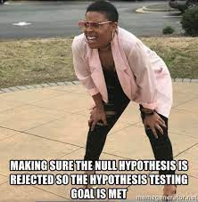
Hypothesis testing
P value (small) p < 0.05 null hypothesis is rejected
P value (large) p > 0.05 null hypothesis is accepted.

Slide 7
Example
Is it true that vitamin C has the ability to cure or prevent the common cold? Or is it just a myth? There's nothing like an in-depth experiment to get to the bottom of it all. A potential hypothesis test could look something like this:
Null hypothesis - Children who take vitamin C are no less likely to become ill during flu season.
Alternative hypothesis - Children who take vitamin C are less likely to become ill during flu season.
Significance level - The significance level is 0.05.
P-value - The p-value is calculated to be 0.20.
Conclusion - After conducting your statistical analysis on the results, you determine a p-value of 0.20. That is above the desired significance level of 0.05, and thus you fail to reject the null hypothesis. Based on your experiment, there is no support for the (alternative) hypothesis that vitamin C can prevent colds.

Slide 8
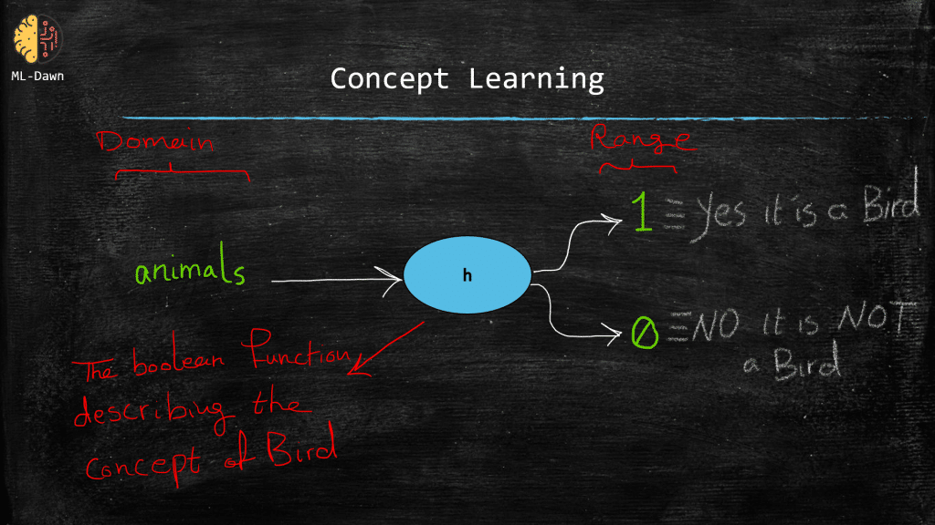
Concept
Concept- show as a Boolean function

Slide 9
Hypothesis-Constraints
a hypothesis could be shown as a vector of some constraints on the attributes.
a hypothesis consists of 3 constraints.
Totally free of constraint -???? (Constraint does not have an important role)
Strong constraint on the value of the attribute: specified by the exact required value for that particular attribute
Strong constraint regardless of the value of the attribute

Slide 10
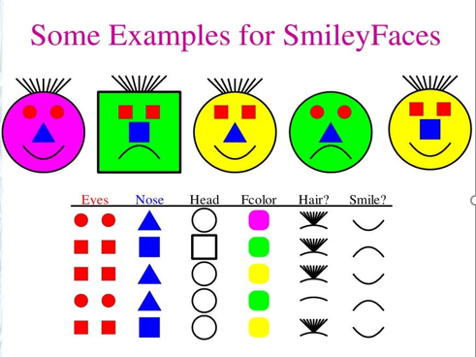
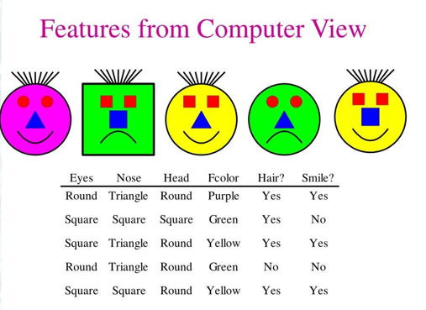
Ground truth or target concept

Slide 11
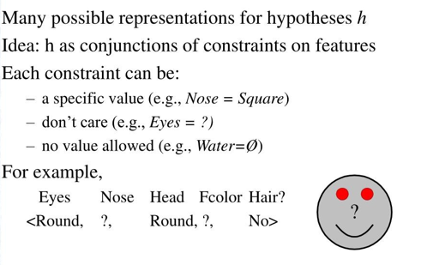
Hypotheses-Representation

Slide 12
Example-Hypotheses
H1: ( ?, Triangle,Round,?,?)
☺ will have triangle eyes and round face
H2: Most general hypothesis
(?,?,?,?,?) all faces ☺
H3: Most specific possible hypothesis
(Ø, Ø, Ø, Ø, Ø) No faces will ☺

Slide 13
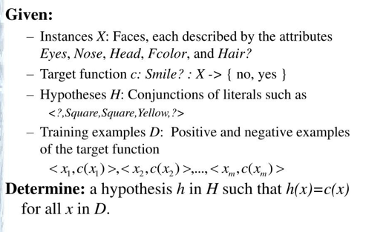
Prototypical Concept Learning Task

Slide 14
For a positive training example x, C(x)=1 and for a negative training example C(x) = 0
The main job of the learner is to hypothesize and find a hypothesis h such that for every training example x in the training set: h(x) = C(x)

Slide 15


Inductive Learning Hypothesis
Any hypothesis found to approximate the target function well over a sufficiently large set of training examples will also approximate the target function well over other unobserved examples

Slide 16
Fundamental assumption of the inductive learning hypothesis
During training, the best hypothesis for the future unseen data, is the one that best fits the available training examples where h(x) = C(x) for every x in our training set.
Instance space = 48 instances (Eyes,Nose,Fcolor,Hair,Round)
Syntactically distinct Hypotheses values= 5*4*4*4*4=1280
(Includes Two more values for attributes: ? and 0)
Every hypothesis containing one or more 0 symbols represents the empty set of instances; that is, it classifies every instance as negative.
Semantically distinct Hypotheses values(Only one more value for attributes: ?, and one hypothesis representing empty set of instances)
= 4*3*3*3*3 = 324+(1 empty set) = 325

Slide 17
Many learning algorithms for concept learning organize the search through the hypothesis space by relying on a general-to-specific ordering of hypotheses.
By taking advantage of this naturally occurring structure over the hypothesis space, we can design learning algorithms that exhaustively search even infinite hypothesis spaces without explicitly enumerating every hypothesis.
Study of learning algorithms that examine different strategies for searching the hypothesis space,
– Find-S Algorithm
– List-Then-Eliminate Algorithm
– Candidate Elimination Algorithm

Slide 18
More-General-Than Relation
For any instance x in X and hypothesis h in H, we say that x satisfies h if and only if h(x) = 1.
More-General-Than-Or-Equal Relation: Let h1 and h2 be two boolean-valued functions defined over X. Then h1 is more-general-than-or-equal-to h2 (written h1 ≥ h2) if and only if any instance that satisfies h2 also satisfies h1.
h1 is more-general-than h2 ( h1 > h2) if and only if h1≥h2 is true and h2≥h1 is false. We also say h2 is more-specific-than h1

Slide 19
Example
h1 =<?, Square,Round,yellow, ?>
h2= < ?,?,round,?,?>
h2 is more general than h1
Since h2 imposes fewer constraints on the instance, it classifies more instances as positive

Slide 20
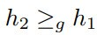
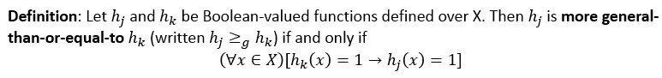
more-general-than-or-equal-to
Hypothesis h1 and h2 classifies the instance x as positive can written as h1(x) = 1 and h2(x) = 1.
Now h2 is more general than h1, so it can be written as if h1(x) = 1 implies h2(x) = 1.

Slide 21
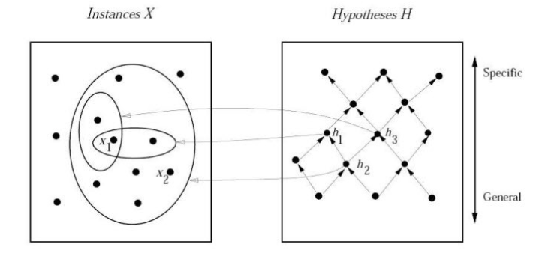
more-specific-than

Slide 22
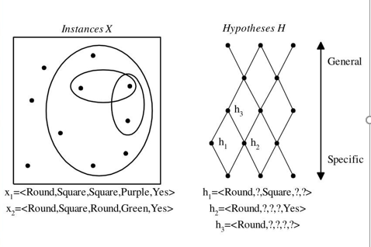
General to specific ordering of hypotheses
By taking advantage of this naturally occurring structure over the hypothesis space, we can design learning algorithms that exhaustively search even infinite hypothesis spaces without explicitly enumerating every hypothesis

Slide 23

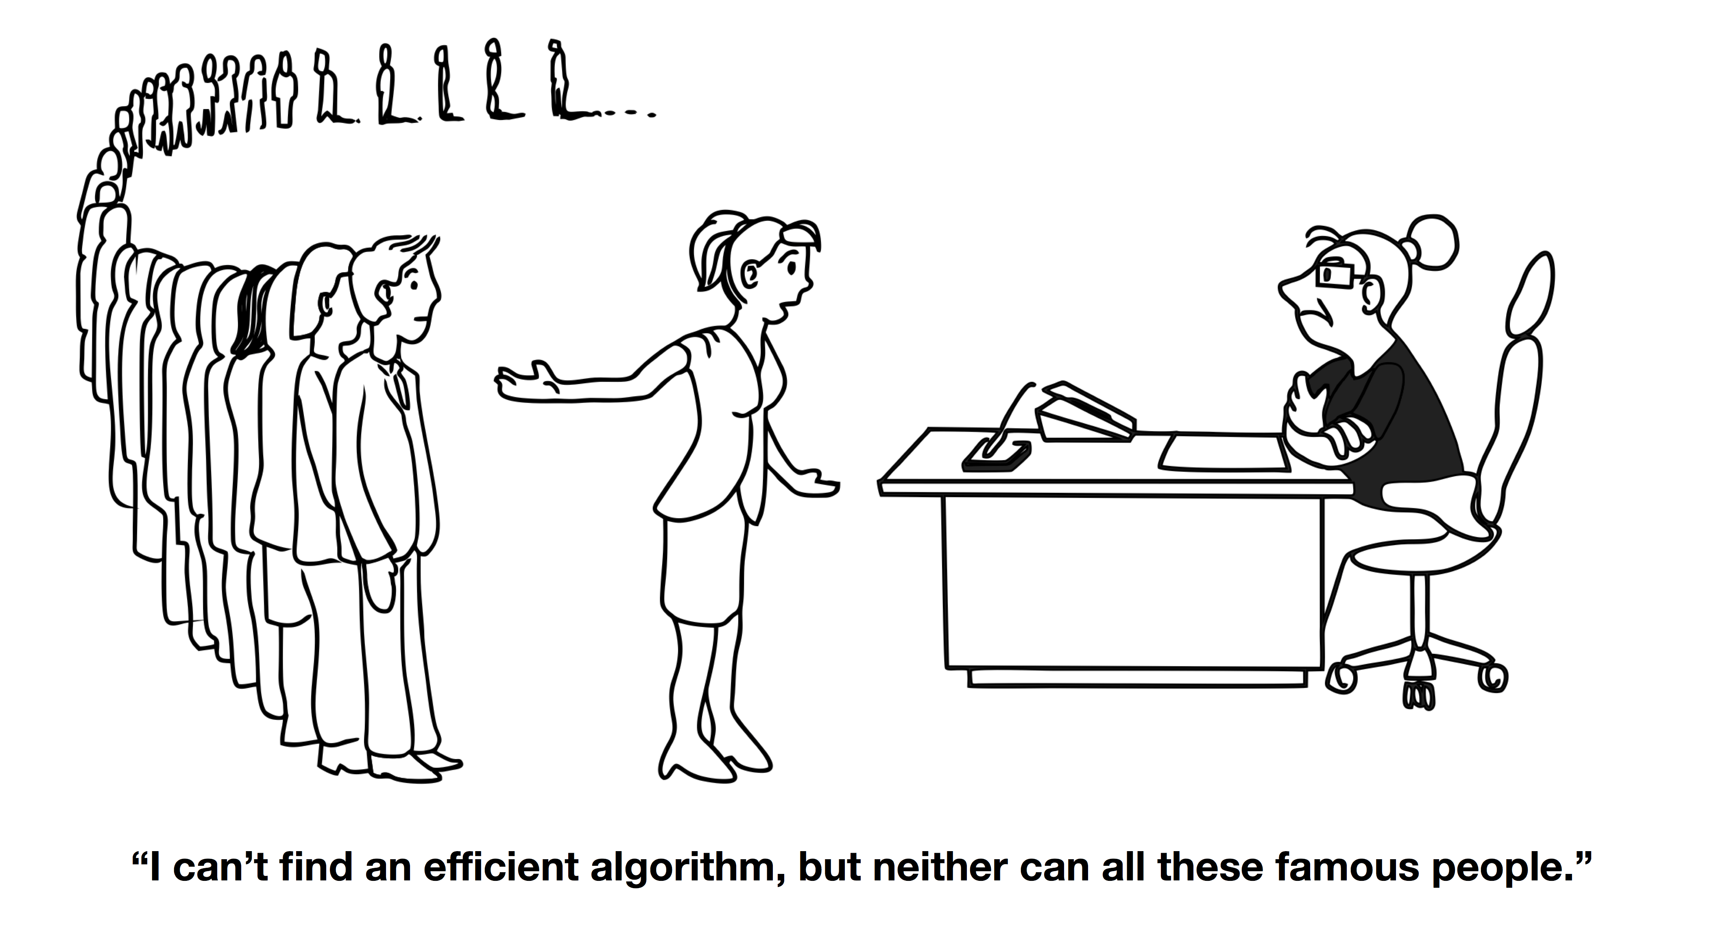
FIND-S Algorithm
Goal→ To find the maximally specific hypothesis
Important point: Considers only positive results and ignores –ve results.

Slide 24
1. Initialize h to the most specific hypothesis in H
2. For each positive training instance x
For each attribute constraint a, in h
If the constraint a, is satisfied by x
Then do nothing
Else replace a, in h by the next more general constraint that is satisfied by x
3. Output hypothesis h

Slide 25
FIND-S Algorithm
Representations:
The most specific hypothesis is represented using ϕ.
The most general hypothesis is represented using ?.

Slide 26
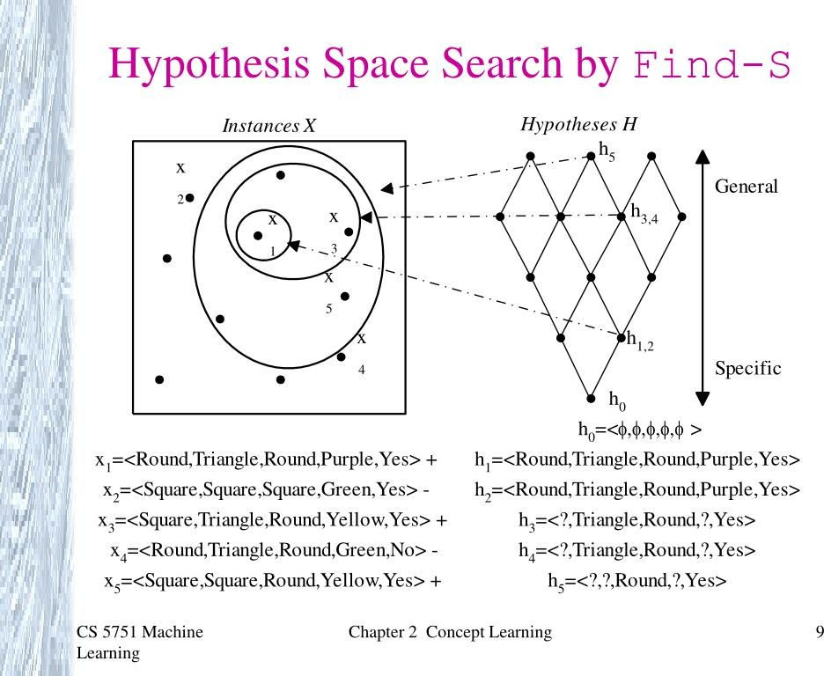

Slide 27
FIND-S Algorithm
FIND-S Algorithm starts from the most specific hypothesis and generalize it by considering only positive examples.
FIND-S algorithm ignores negative examples.
As long as the hypothesis space contains a hypothesis that describes the true target concept, and the training data contains no errors, ignoring negative examples does not cause to any problem.
• FIND-S algorithm finds the most specific hypothesis within H that is consistent with the positive training examples.
The final hypothesis will also be consistent with negative examples if the correct target concept is in H, and the training examples are correct.

Slide 28
Limitations in Find-S
Can not tell whether it has learned concept (Output only one. Many other consistent hypotheses may exist!)
Picks a maximally specific h (why?) (Find a most specific hypothesis consistent with the training data)
Can not tell when training data inconsistent
What if there are noises or errors contained in training examples
Depending on H, there might be several maximally specific hypotheses consistent with the data

Slide 29
Consistent and Version Space
A hypothesis h is consistent with a set of training examples D if and only if h(x) = c(x) for each example (x, c(x)) in D.
A training example x is said to satisfy hypothesis h when h(x) = 1, regardless of whether x is a positive or negative example of the target concept.
An example x is said to consistent with hypothesis h iff h(x) = c(x)

Slide 30
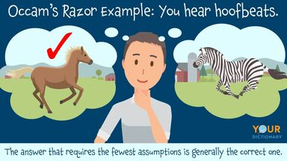

Find out the consistent hypothesis
?,?, R,G,yes--→
?,?,R,?,yes->
?,T,?,y,?->

Slide 31
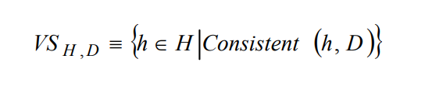
version space
The version space VS_{H,D} with respect to hypothesis space H and training examples D is the subset of hypotheses from H consistent with all training examples in D
H(x)= c(x)

Slide 32
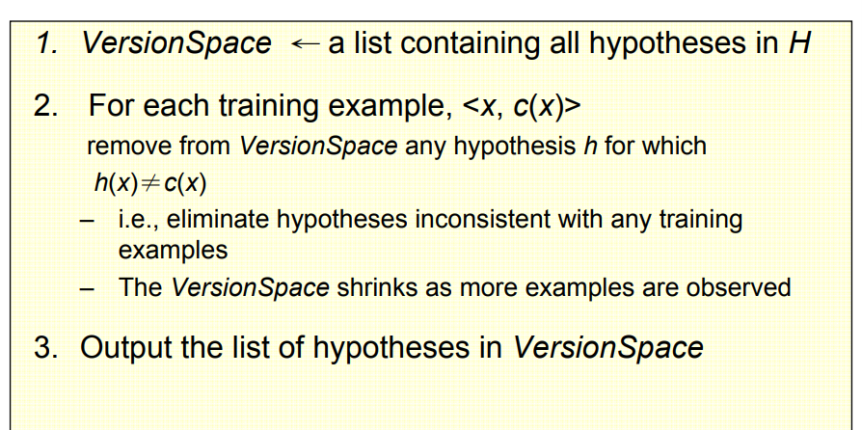
List-Then-Eliminate Algorithm

Slide 33
h1= ?,?,Round,?,Yes

Slide 34
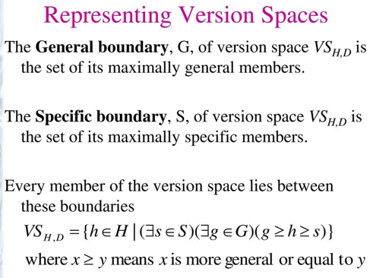

Slide 35
Candidate-Elimination Algorithm
FIND-S outputs a hypothesis from H, that is consistent with the training examples, this is just one of many hypotheses from H that might fit the training data equally well.
The key idea in the Candidate-Elimination algorithm is to output a description of the set of all hypotheses consistent with the training examples.
Candidate-Elimination algorithm computes the description of this set without explicitly enumerating all of its members.
This is accomplished by using the more-general-than partial ordering and maintaining a compact representation of the set of consistent hypotheses.

Slide 36
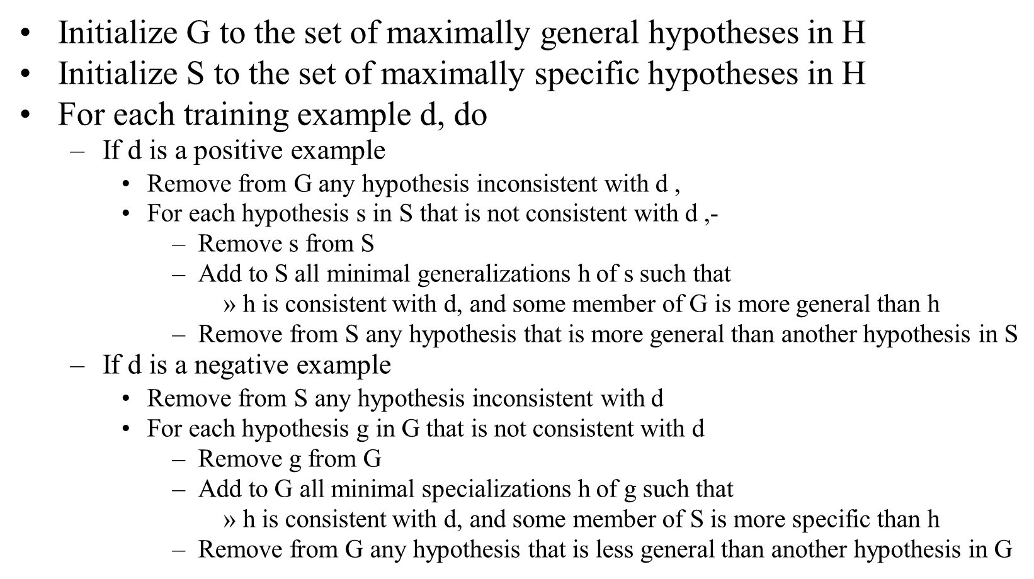
Candidate Elimination Algorithm

Slide 37
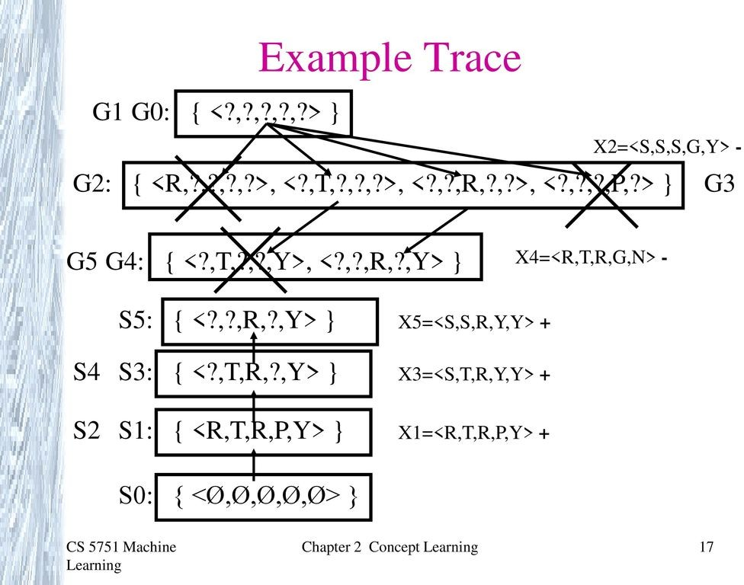

Slide 38
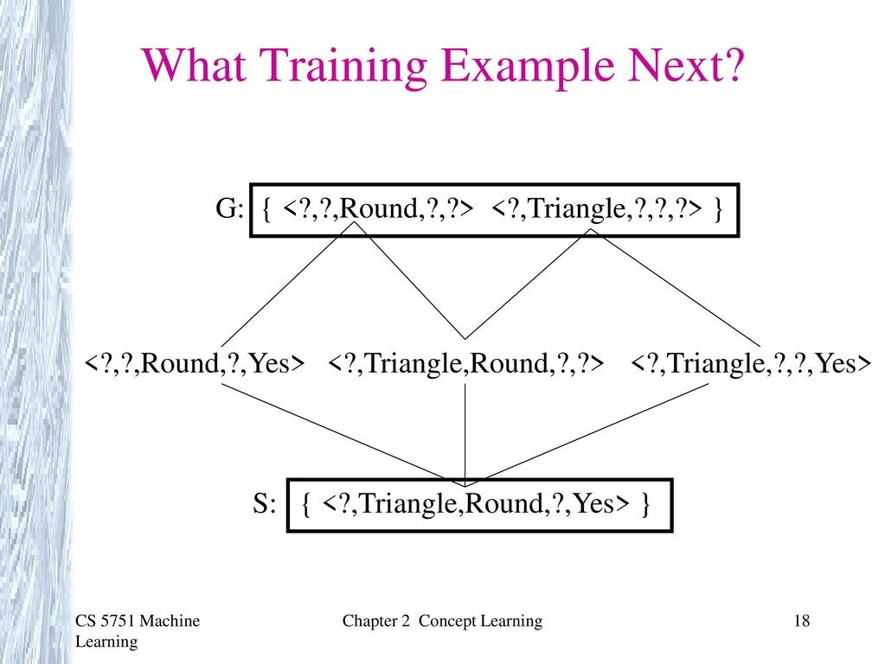

Slide 39
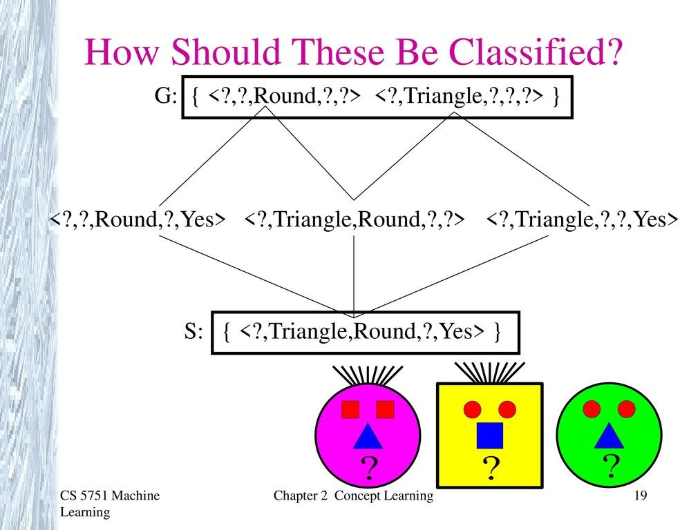

Slide 40
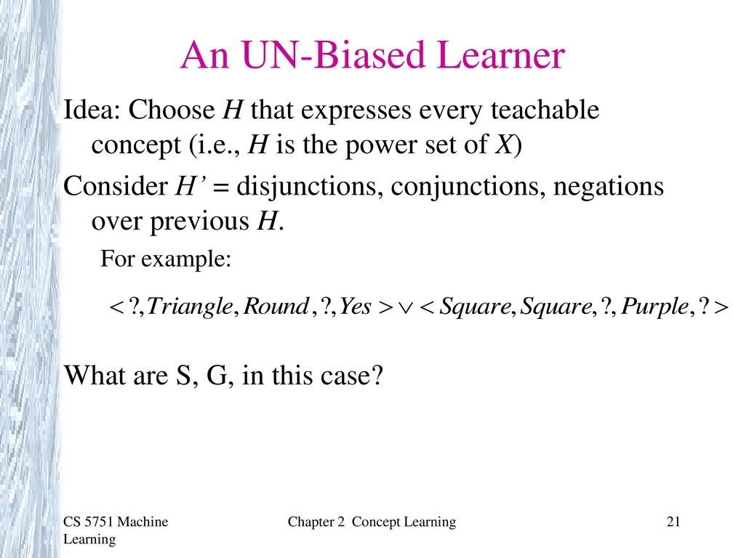
3 +ve : disjunction 2 –ve negation of disjunction

Slide 41
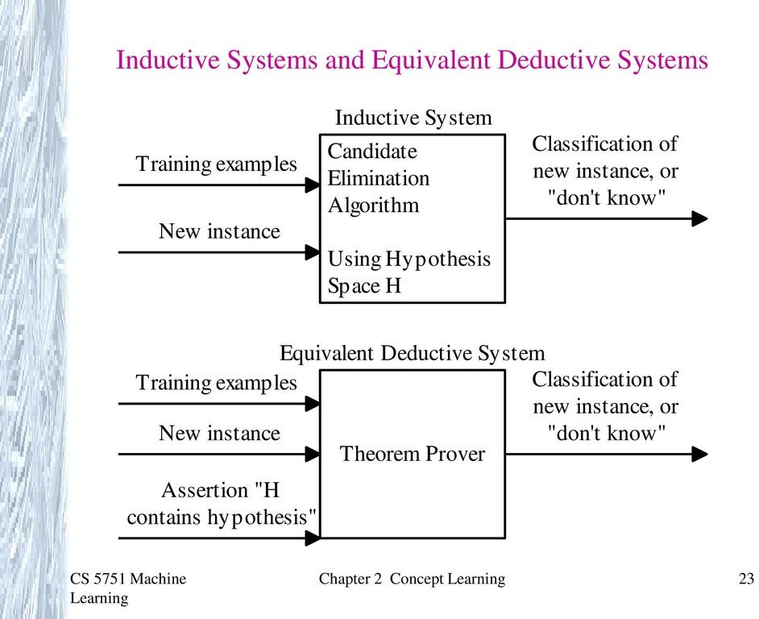

Slide 42
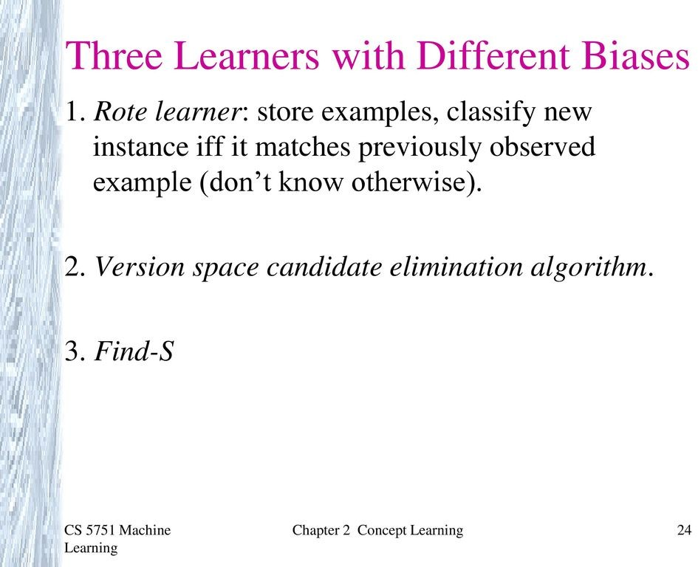

Slide 43
Issues in ML
Good hypothesis space
Algorithms that work with the hypothesis space
Optimization of accuracy(overfitting)
Confidence in the results
Are some learning problems completely intractable?

Slide 44
Final Inferences
Errors – bias and variance
Bias- restriction in hypothesis space
(incorrect assumptions)
Variance- variance among the results

Slide 45
Underfitting and overfitting
Underfitting- Model(simple) to denote all the related features
high bias and low variance
High training error and test error
Overfitting –Model (complex and fits all non-related features
low bias and high variance
Low training error and test error

